Slide 1
My Internship POL
Jennifer Perry

Slide 2
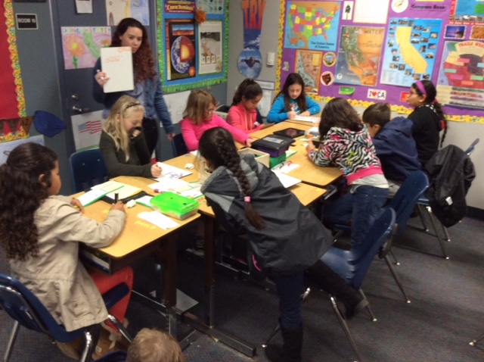
My Work as an Intern
As an intern at Cajon Park I’ve been working Mrs. Fields’s fourth grade class. There are thirty-three students in total so I usually have a small group for math.

Slide 3
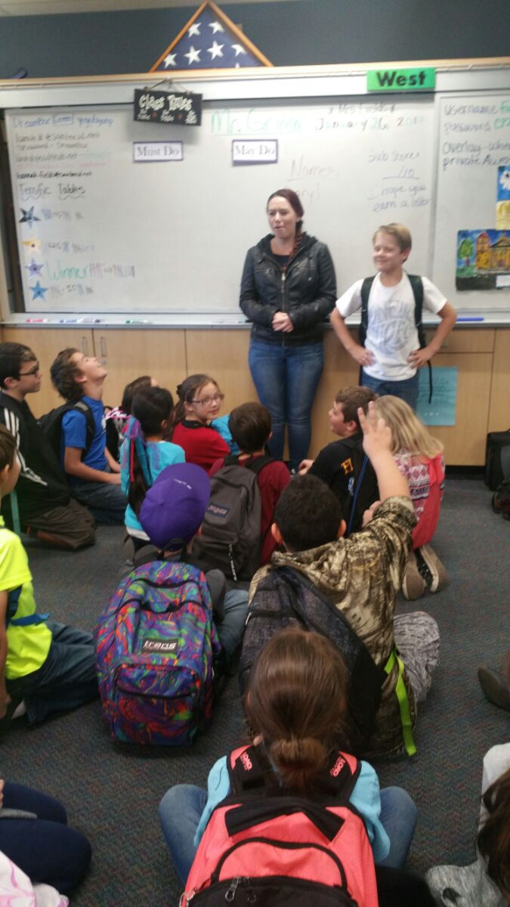
My project has been to have the kids work on their writing. I taught a couple lessons and had them write but I’ve also been going up teaching the kids at least once a day. I have definitely gained a lot more patience and I feel that I am able to explain things in more ways than I really thought. If a student doesn’t understand something then I have to find a new way to explain it which was hard at first but I have gotten better at it and will continue to do so.

Slide 4
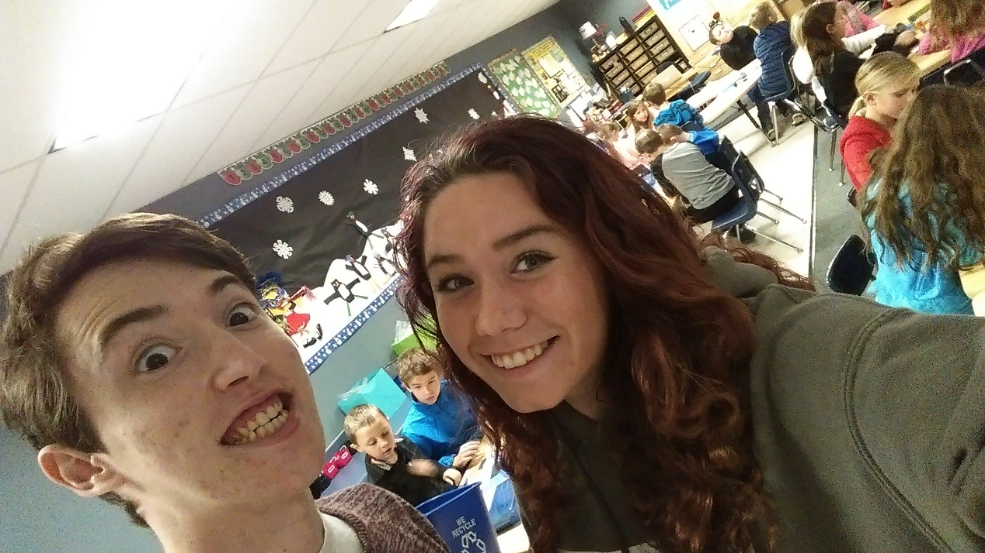

Slide 5
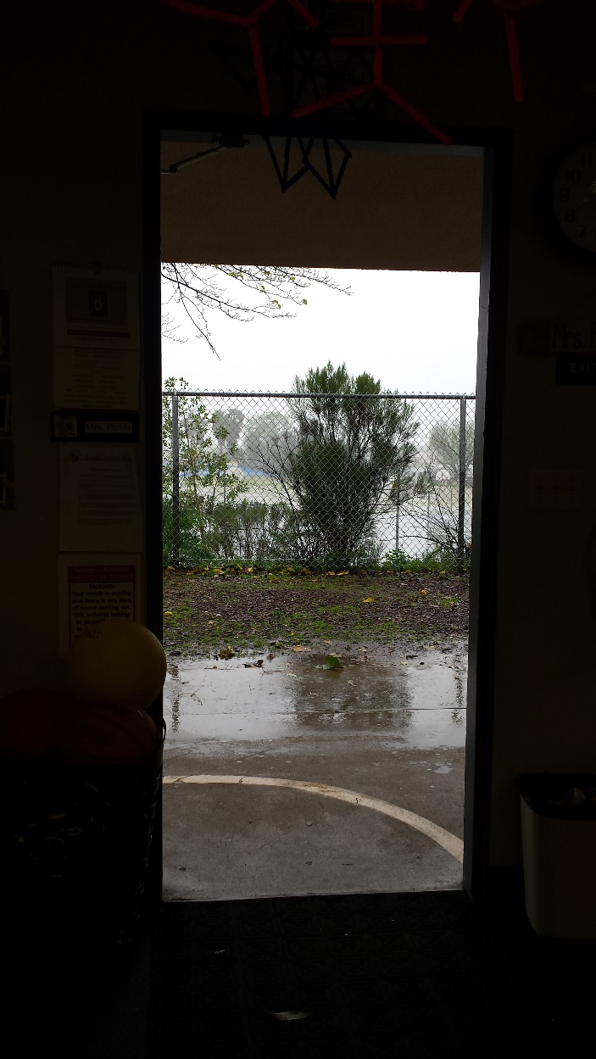
Life outside of High School
While working here I have definitely developed a much deeper appreciation for teachers who teach fifth grade and below. They are extremely patient and I can’t wait to become a teacher. After high school I definitely plan on getting my teaching credentials and teaching elementary school and maybe even high school.

Slide 6
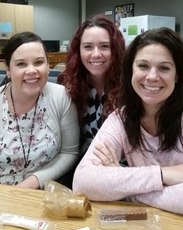
A professional working environment is needed in every workplace but in a school it’s a little different. The teachers and other staff have to get along or it just doesn’t work. They don’t have to be best friends but they do have to be nice so they can get to an agreement on group activities.

Slide 7
In Conclusion...
I have absolutely loved being at this internship. The kids have been wonderful and all the teachers have been very kind and willing to answer any and all questions I’ve had. After being here I’ve decided that I definitely want to teach elemntary in the future.

